Slide 1
Email Architecture And Services With User Agent
By Laphrangki Khyriem
Bankit B Nongbet
MCA 4th SEM

Slide 2
Electronic Mail (Email)
Electronic mail, or e-mail, as it is known to its many fans, has been around for over two decades.
Before 1990, it was mostly used in academia. During the 1990s, it became known to the public at large and grew exponentially to the point where the number of e-mails sent per day now is vastly more than the number of snail mail (i.e., paper) letters.
E-mail, like most other forms of communication, has its own conventions and styles. In particular, it is very informal and has a low threshold of use. People who would never dream of calling up or even writing a letter to a Very Important Person do not hesitate for a second to send a sloppily-written e-mail.
E-mail is full of jargon such as BTW (By The Way), ROTFL (Rolling On The Floor Laughing), and IMHO (In My Humble Opinion). Many people also use little ASCII symbols called smileys or emoticons in their e-mail.

Slide 3
Architecture and Services
The architecture of the email system is shown in Fig. 7-7.
It consists of two kinds of subsystems:
the user agents, which allow people to read and send email, and
the message transfer agents, which move the messages from the source to the destination. We will also refer to message transfer agents informally as mail servers.
The user agents are local programs that provide a command-based, menu-based, or graphical method for interacting with the e-mail system. The message transfer agents are typically system daemons, that is, processes that run in the background. Their job is to move e-mail through the system.

Slide 4
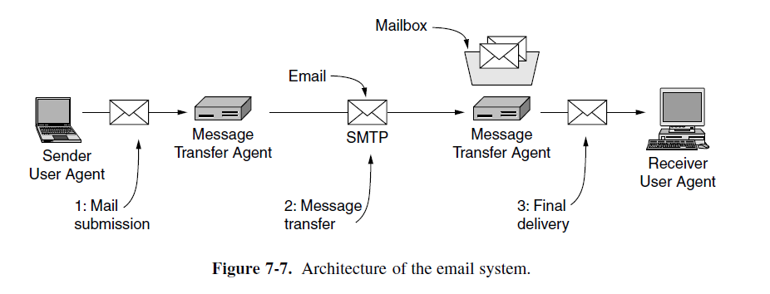
Architecture and Services

Slide 5
Architecture and Services
Typically, e-mail systems support five basic functions :
Composition refers to the process of creating messages and answers. Although any text editor can be used for the body of the message, the system itself can provide assistance with addressing and the numerous header fields attached to each message. For example, when answering a message, the e-mail system can extract the originator's address from the incoming e-mail and automatically insert it into the proper place in the reply.
Transfer refers to moving messages from the originator to the recipient. In large part, this requires establishing a connection to the destination or some intermediate machine, outputting the message, and releasing the connection. The e-mail system should do this automatically, without bothering the user.

Slide 6
Architecture and Services
Reporting has to do with telling the originator what happened to the message. Was it delivered? Was it rejected? Was it lost? Numerous applications exist in which confirmation of delivery is important and may even have legal significance (''Well, Your Honor, my e-mail system is not very reliable, so I guess the electronic subpoena just got lost somewhere'').
Displaying incoming messages is needed so people can read their e-mail. Sometimes conversion is required or a special viewer must be invoked, for example, if the message is a PostScript file or digitized voice. Simple conversions and formatting are sometimes attempted as well.
Disposition is the final step and concerns what the recipient does with the message after receiving it. Possibilities include throwing it away before reading, throwing it away after reading, saving it, and so on. It should also be possible to retrieve and reread saved messages, forward them, or process them in other ways.

Slide 7
Architecture and Services
In addition to these basic services, some e-mail systems, especially internal corporate ones, provide a variety of advanced features. When people move or when they are away for some period of time, they may want their e-mail forwarded, so the system should be able to do this automatically.
Most systems allow users to create mailboxes to store incoming e-mail. Commands are needed to create and destroy mailboxes, inspect the contents of mailboxes, insert and delete messages from mailboxes, and so on.
Corporate managers often need to send a message to each of their subordinates, customers, or suppliers. This gives rise to the idea of a mailing list, which is a list of e-mail addresses. When a message is sent to the mailing list, identical copies are delivered to everyone on the list.

Slide 8
Architecture and Services
Other advanced features are carbon copies, blind carbon copies, high-priority e-mail, secret (i.e., encrypted) e-mail, alternative recipients if the primary one is not currently available, and the ability for secretaries to read and answer their bosses' e-mail.
A key idea in e-mail systems is the distinction between the envelope and its contents. The envelope encapsulates the message. It contains all the information needed for transporting the message, such as the destination address, priority, and security level, all of which are distinct from the message itself. The message transport agents use the envelope for routing, just as the post office does.
The message inside the envelope consists of two parts: the header and the body. The header contains control information for the user agents. The body is entirely for the human recipient.

Slide 9
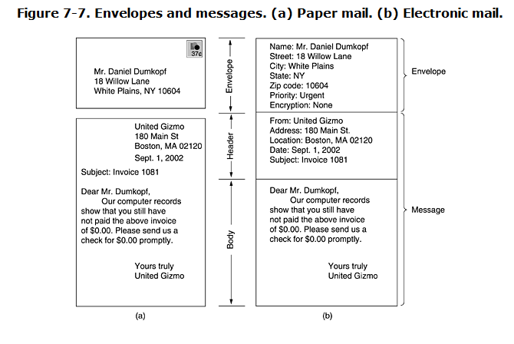
Architecture and Services

Slide 10
The User Agent
A user agent is normally a program (sometimes called a mail reader) that accepts a variety of commands for composing, receiving, and replying to messages, as well as for manipulating mailboxes.
Some user agents have a fancy menu- or icon-driven interface that requires a mouse, whereas others expect 1-character commands from the keyboard. Functionally, these are the same. Some systems are menu- or icon-driven but also have keyboard shortcuts.
Eg
Google gmail, Microsoft Outlook, Mozilla Thunderbird, and Apple Mail.

Slide 11
The User Agent
Sending E-mail:
To send an e-mail message, a user must provide the message, the destination address, and possibly some other parameters. The message can be produced with a free-standing text editor, a word processing program, or possibly with a specialized text editor built into the user agent.
The destination address must be in a format that the user agent can deal with. Many user agents expect addresses of the form user@dns-address.
Most e-mail systems support mailing lists, so that a user can send the same message to a list of people with a single command. If the mailing list is maintained locally, the user agent can just send a separate message to each intended recipient. However, if the list is maintained remotely, then messages will be expanded there.

Slide 12
The User Agent
Reading E-mail :
Typically, when a user agent is started up, it looks at the user's mailbox for incoming e-mail before displaying anything on the screen. Then it may announce the number of messages in the mailbox or display a one-line summary of each one and wait for a command.
example of how a user agent works, After starting up the user agent, the user asks for a summary of his e-mail. A display like that of Fig. 7-8 then appears on the screen. Each line refers to one message.

Slide 13
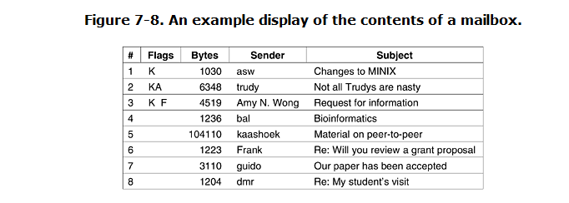
The User Agent

Slide 14
The User Agent
The first field is the message number. The second field, Flags, can contain a K, meaning that the message is not new but was read previously and kept in the mailbox; an A, meaning that the message has already been answered; and/or an F, meaning that the message has been forwarded to someone else.
The third field tells how long the message is, and the fourth one tells who sent the message. Since this field is simply extracted from the message, this field may contain first names, full names, initials, login names, or whatever else the sender chooses to put there. Finally, the Subject field gives a brief summary of what the message is about.
People who fail to include a Subject field often discover that responses to their e-mail tend not to get the highest priorityOther flags are also possible.
After the headers have been displayed, the user can perform any of several actions, such as displaying a message, deleting a message, and so on.

Slide 15
References
https://sites.google.com/site/assignmentssolved/mca/semester3/mc0075/28
Computer Networks 4th Ed - Andrew S. Tanenbaum
Computer Networks - A Tanenbaum - 5th edition

